Slide 1
DSC – 530 Exploratory Data Analysis
Mayuri Ande

Slide 2
Introduction
Perform exploratory data analysis on Gym membership dataset.
This analysis address the relation between various attributes collected in gym, based on the variables.
Calories burned during a Gym session. Factors that have impact in calories burned in the session.

Slide 3
Variables part of Analysis
Age: Age of the customer in years.
BMI: Body Mass Index.
WorkoutDuration: Duration of workout in minutes.
CaloriesBurned: Number of calories burned during workouts.
Workout_Frequency: Duration of gym membership in months.

Slide 4
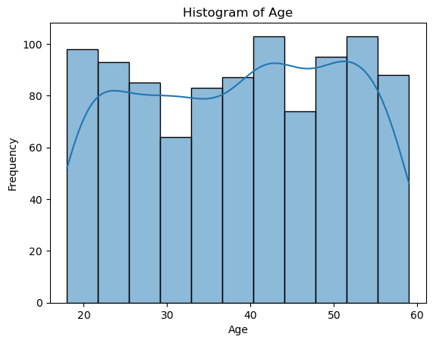
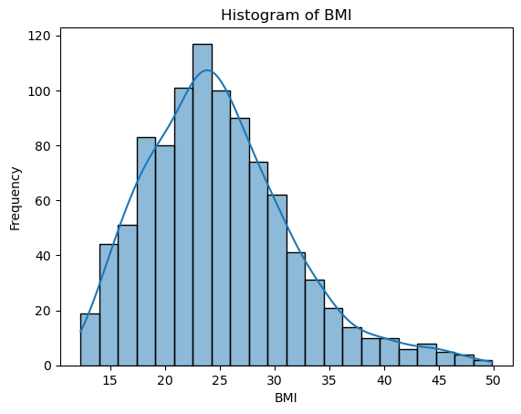
Summary Analysis of variables

Slide 5
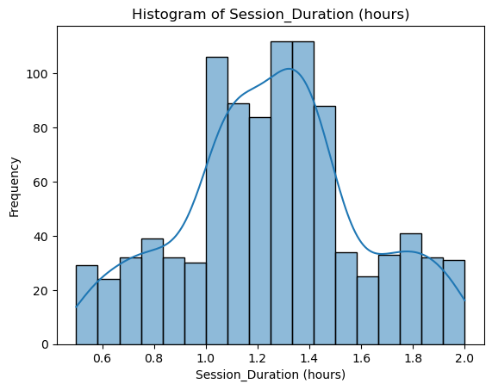
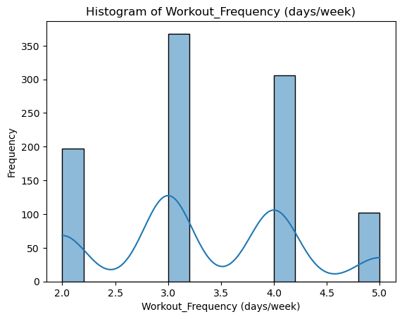
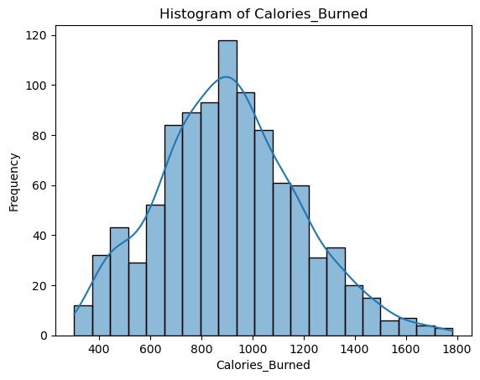
Summary Analysis of Variables

Slide 6
Summary Analysis of Variables
Age: Dataset has the customer information between 20 to 50 years
BMI:The distribution of data is right skewed. Most of the data is having BMI less than 25.
WorkoutDuration: Most of the members have worked out for 1 hr to 1.4 hr and comparatively the are less number customers that work less than 1 hr or more than 1.4 hr
CaloriesBurned: The graph is mostly right skewed, there are few customers that burn more calories
Workout_Frequency: There are more people workout 3 days or less compared to 4 days.
There are no outliers. If outliers are found, update missing values with most frequent values.

Slide 7
Descriptive Analysis
Descriptive Statistics: Age BMI Session_Duration (hours) Calories_Burned count 973.000000 973.000000 973.000000 973.000000 mean 38.683453 24.912127 1.256423 905.422405 std 12.180928 6.660879 0.343033 272.641516 min 18.000000 12.320000 0.500000 303.000000 25% 28.000000 20.110000 1.040000 720.000000 50% 40.000000 24.160000 1.260000 893.000000 75% 49.000000 28.560000 1.460000 1076.000000 max 59.000000 49.840000 2.000000 1783.000000 Workout_Frequency (days/week) count 973.000000 mean 3.321686 std 0.913047 min 2.000000 25% 3.000000 50% 3.000000 75% 4.000000 max 5.000000

Slide 8
Descriptive Analysis
Age: Average of individuals in dataset are 38.68
BMI: Average BMI is 24.6%
WorkoutDuration: Average workout duration is 1.26 hours
CaloriesBurned: Average calories burned 905.42.
Workout_Frequency: Average Workout frequency is around 3 days

Slide 9
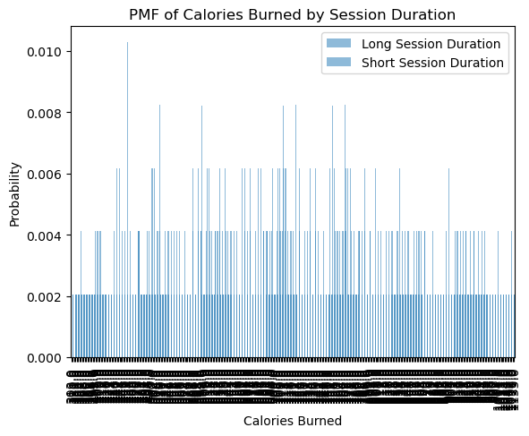
PMF Analysis between Short session and long session
Here are we comparing the probability where sessions with less duration and session with long duration.
There are more sessions with less calories burned and short session

Slide 10
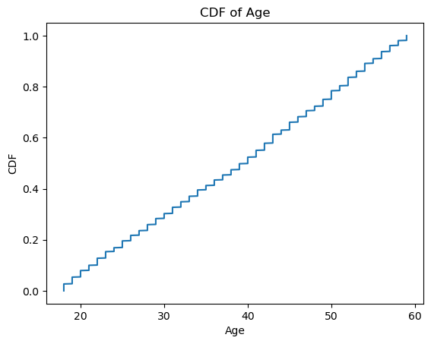
CDF with Age
Cumulative Distribution Function shows nearly a straight line showing the distribution is evenly distributed in the age range od 20 to 60

Slide 11

Analytical distribution with BMI
Analytical distribution of BMI shoes that the most of the people in dataset are around 25 BMI showing helathy weight

Slide 12
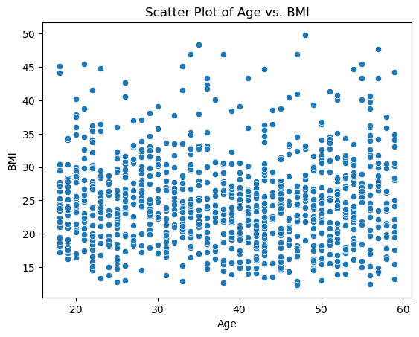
Scatter Plots between Age and BMI
Scatter plots between Age and BMI shows the age and BMI are scattered across the plot and confirms there are many factors in addition to age determines the BMI.
Pearson's correlation coefficient (Age vs. BMI): -0.013691370282822085
Pearson correlation also signifies that there is no linear relationship between Age and BMI

Slide 13
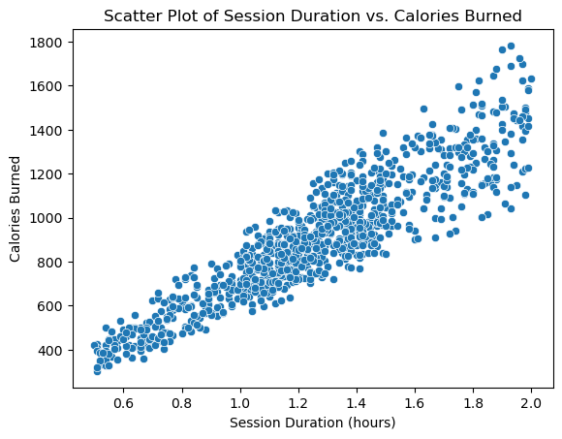
Scatter Plots between Age and BMI
The scatter plot shows that there is strong relation between session duration and calories burnt.
As the session increases, calories burnt also increases.
Pearson's correlation coefficient (Session Duration vs. Calories Burned): 0.9081403755270134
Pearson correlation of 0.98 also indicated the linear relationship between calories burnt and session duration.

Slide 14
Hypothesis Test Results
Hypothesis testing is done for comparing the results of long duration vs short duration sessions
T-test results: t-statistic = 33.55109193972389, p-value = 1.715516348654719e-164
Show drafts
T-statistic is higher indicating there is significant difference in the calories burnt between both the sessions.
Pvalue is very low indicating indicting there is difference in both the groups.

Slide 15
Regression Analysis between Age, Session and workout frequency
OLS Regression Results ============================================================================== Dep. Variable: Calories_Burned R-squared: 0.843 Model: OLS Adj. R-squared: 0.843 Method: Least Squares F-statistic: 1740. Date: Sat, 16 Nov 2024 Prob (F-statistic): 0.00 Time: 23:52:46 Log-Likelihood: -5934.7 No. Observations: 973 AIC: 1.188e+04 Df Residuals: 969 BIC: 1.190e+04 Df Model: 3 Covariance Type: nonrobust ================================================================================= coef std err t P>|t| [0.025 0.975] ---------------------------------------------------------------------------------------- const 122.9567 18.167 6.768 0.000 87.306 158.607 Age -3.0538 0.285 -10.728 0.000 -3.612 -2.495 Session_Duration (hours) 724.8513 13.215 54.853 0.000 698.919 750.784 Workout_Frequency (days/week) -3.0473 4.964 -0.614 0.539 -12.789 6.694 ============================================================================== Omnibus: 5.285 Durbin-Watson: 2.097 Prob(Omnibus): 0.071 Jarque-Bera (JB): 5.236 Skew: 0.179 Prob(JB): 0.0729 Kurtosis: 3.026 Cond. No. 225. ==============================================================================

Slide 16
Regression Analysis between Age, Session and workout frequency
The positive coeffecient of session duration and calories burnt , shows that it is the strongest predictor based on co-efficient magnitude
Age with negative coefficient indicates that the calories burnt decreases with increase in Age
Work out frequence -More the workout frequency , calores burnt will be decreased.

